Slide 1
RIP with InterVlan configuration
In Cisco Packet Tracer
Author Name:- Shashi Kant
Inspired by:- Sandip Sir (Indian Cyber Security Solutions)
Date:- 23/07/2018
Now before starting this configuration what is RIP---
It is distance vector protocol. It depends on UDP. It has two versions –Version 1 and Version 2. Version 1 is always classful, version 2 is by default classful but we can make it classless. RIP uses hop counts to calculate route cost. It uses Bellman-Ford algorithm(checks nearest hop). RIP prevents routing loops by Split Horizon(two different router can not send update of a single network) and Poison Reverse method. RIP can use maximum 16 (0-15) hops.

Slide 2
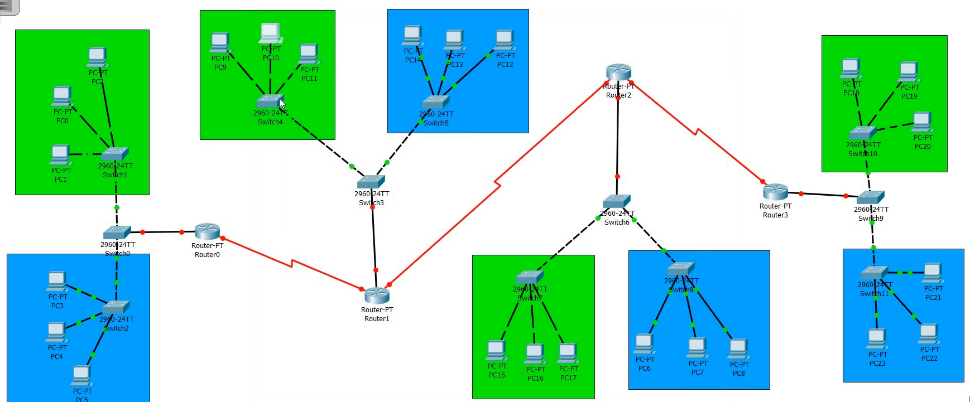
STEPS ARE GIVEN BELOW to make this configuration ::
Step 1:: Let’s start by drawing the model as per the requirements of the configuration.

Slide 3
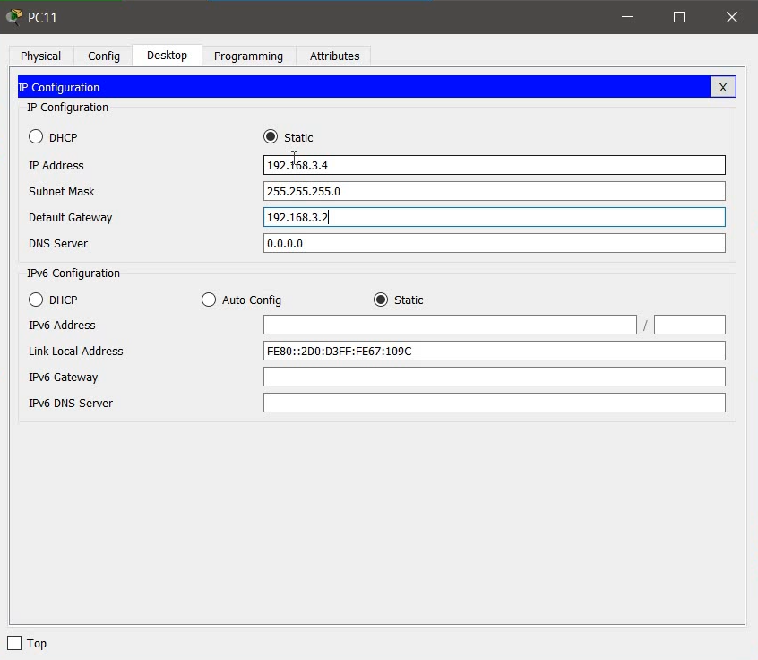
Step 2 :: Now we provide IP address, Subnet Mask and default Gateway to each End devices:
Same for
All other
similar devices

Slide 4
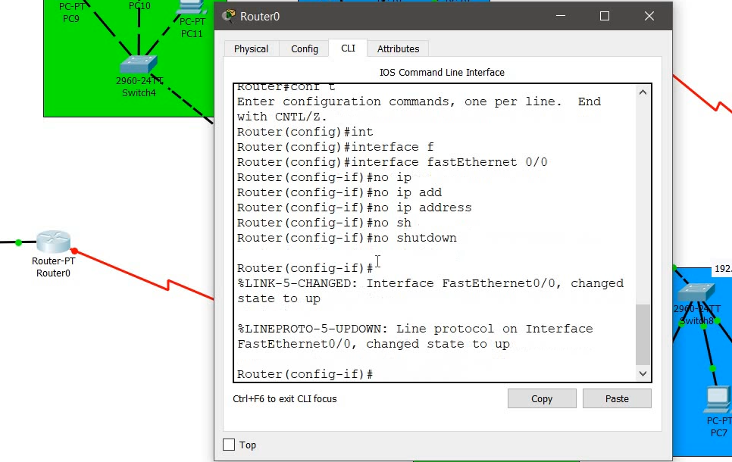
Step 3 :: Now to create InterVlan we start the configuration by typing the following commands in Router : ( i.e. No IP Address )
<Same for all other similar devices>

Slide 5

Step 4 :: Now we do Encapsulation in the router to create InterVlan by typing the following command :
<Same for all other similar devices>

Slide 6
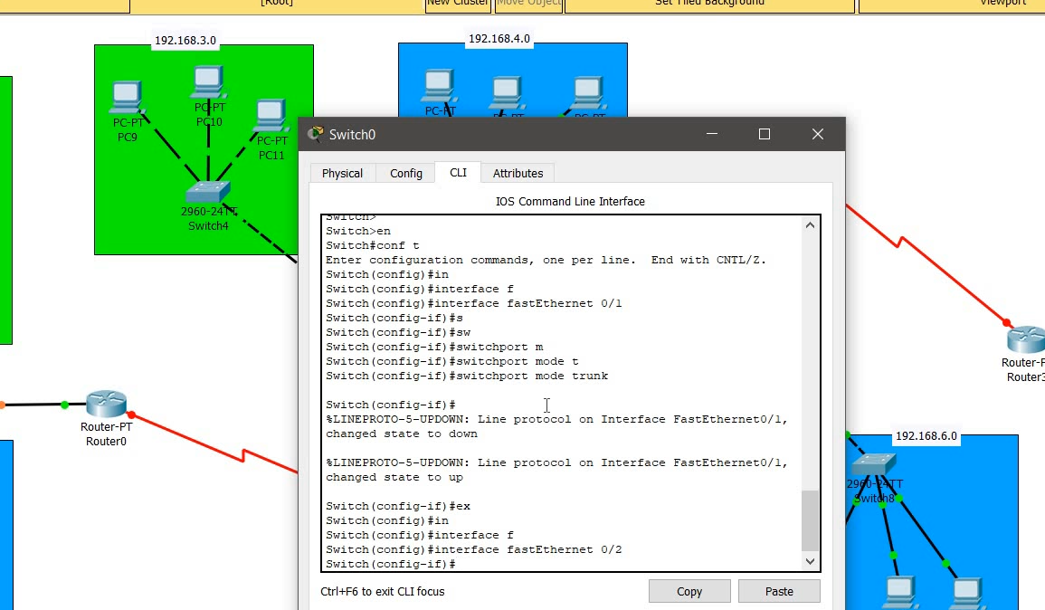
Step 5 :: Now we open Switch and type the following command to Create InterVlan
<Same for all other similar devices>

Slide 7
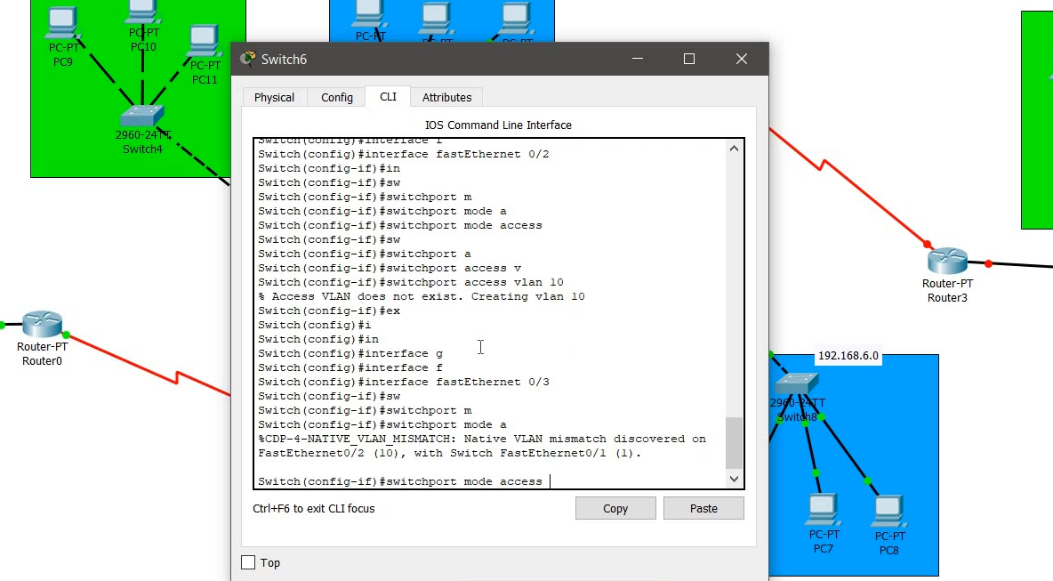
<Same for all other similar devices>

Slide 8
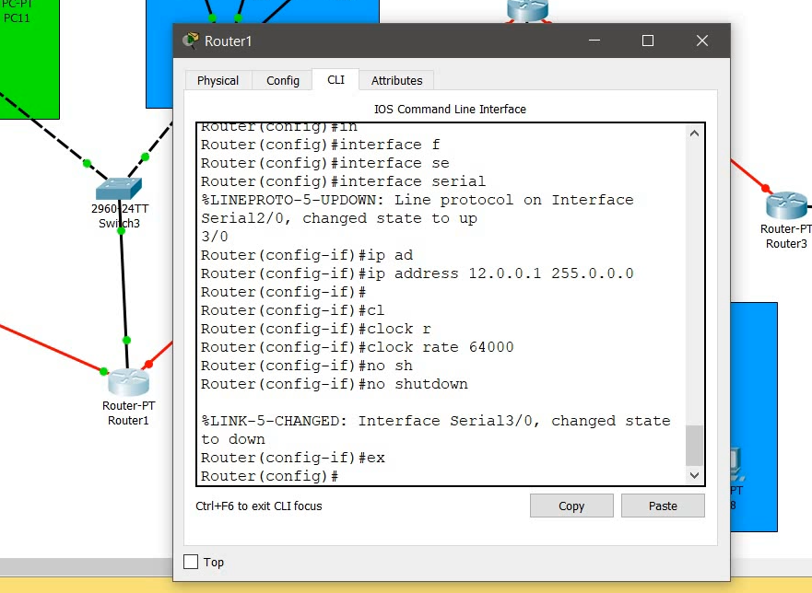
Step 6 :: Now we provide IP address to all the Routers (public IP) with their subnetmasks to every router with Clock Rate (if required)
<Same for all other similar devices>

Slide 9
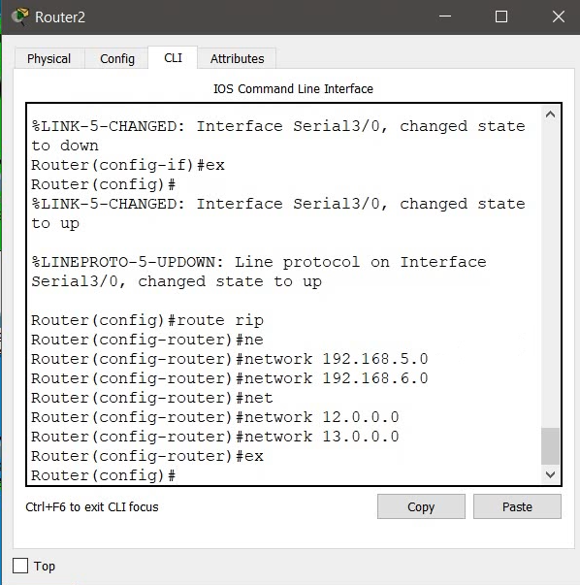
Step 7 :: Now finally to Create RIP we need to type the following command in the Router :
Typing all the network IDs connected to the router.
<Same for all other similar devices>

Slide 10

Finally we check that out Configuration is correct or not, by sending messages all throughout the network

